Slide 1
Chapter 5
Creativity and Innovation

Slide 2

Opportunity Identification:
The Search for New Ideas
Opportunity identification is central to entrepreneurship and involves:
  The creative pursuit of ideas
  The innovation process
The first step for any entrepreneur is the identification of a “good idea.”
  The search for good ideas is never easy.
  Opportunity recognition can lead to both personal and societal wealth.

Slide 3

Entrepreneurial Imagination and Creativity
How entrepreneurs do what they do:
  Creative thinking + systematic analysis = success
  Seek out unique opportunities to fill needs and wants
  Turn problems into opportunities
  Recognize that problems are to solutions what demand is to supply
© 2012 Cengage Learning. All rights reserved.

Slide 4

^{Table} 5.1 Sources of Innovation Ideas
Source | Examples
Unexpected occurrences | Unexpected success: Apple Computer (microcomputers) Unexpected tragedy: 9-11 terrorist attack
Incongruities | Overnight package delivery
Process needs | Sugar-free products Caffeine-free coffee Microwave ovens
Industry and market changes | Health care industry: changing to home health care
Demographic changes | Rest homes or retirement centers for older people
Perceptual changes | Exercise (aerobics) and the growing concern for fitness
Knowledge-based concepts | Mobile (Cell phone) technology; pharmaceutical industry; robotics
© 2012 Cengage Learning. All rights reserved.

Slide 5
The Role of Creative Thinking
Creativity
  The generation of ideas that result in the improved efficiency or effectiveness of a system.
Two important aspects of creativity exist:
  Process
    The process is goal oriented; it is designed to attain a solution to a problem.
  People
    The resources that determine the solution.
© 2012 Cengage Learning. All rights reserved.

Slide 6
^{Table} 5.2 Two Approaches to Creative Problem Solving
Adaptor | Innovator
Employs a disciplined, precise, methodical approach | Approaches tasks from unusual angles
Is concerned with solving, rather than finding, problems | Discovers problems and avenues of solutions
Attempts to refine current practices | Questions basic assumptions related to current practices
Tends to be means oriented | Has little regard for means; is more interested in ends
Is capable of extended detail work | Has little tolerance for routine work
Is sensitive to group cohesion and cooperation | Has little or no need for consensus; often is insensitive to others
Source: Michael Kirton, “Adaptors and Innovators: A Description and Measure,” Journal of Applied Psychology (October 1976): 623. Copyright © 1976 by The American Psychological Association.
© 2012 Cengage Learning. All rights reserved.

Slide 7
The Nature of the Creative Process
Creativity is a process that can be developed and improved. Some individuals have a greater aptitude for creativity than others.
Typical Creative Process
  Phase 1: Background or knowledge accumulation
  Phase 2: The incubation process
  Phase 3: The idea experience
  Phase 4: Evaluation and implementation
© 2012 Cengage Learning. All rights reserved.

Slide 8
^{Table} 5.3 The Most Common Idea “Killers”
1. “Naah.”
2. “Can’t” (said with a shake of the head and an air of finality).
3. “That’s the dumbest thing I’ve ever heard.”
4. “Yeah, but if you did that . . .” (poses an extreme or unlikely disaster case).
5. “We already tried that—years ago.”
6. “I don’t see anything wrong with the way we’re doing it now.”
7. “We’ve never done anything like that before.”
8. “We’ve got deadlines to meet—we don’t have time to consider that.”
9. “It’s not in the budget.”
10. “Where do you get these weird ideas?”
Source: Adapted from The Creative Process, ed. Angelo M. Biondi (Hadley, MA: The Creative Education Foundation, 1986).
© 2012 Cengage Learning. All rights reserved.

Slide 9
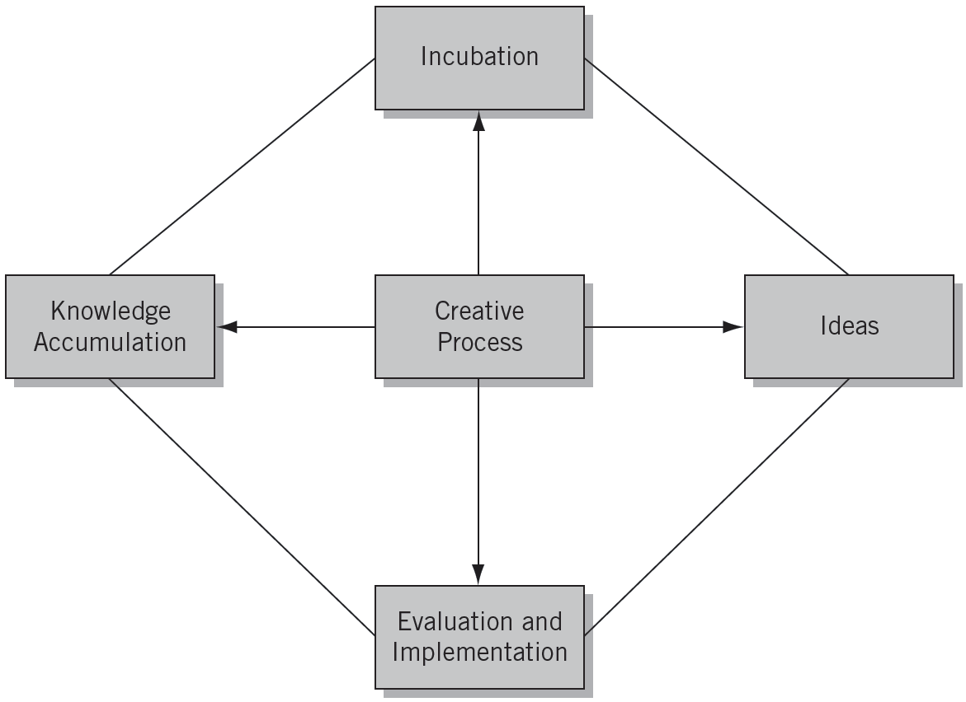
^{Figure} 5.1 The Critical Thinking Process
© 2012 Cengage Learning. All rights reserved.

Slide 10
Developing Your Creativity
Recognizing Relationships
  Looking for different or unorthodox relationships among the elements and people around you.
Developing a Functional Perspective
  Viewing things and people in terms of how they can satisfy his or her needs and help complete a project.
Using Your Brains
  The right brain helps us understand analogies, imagine things, and synthesize information.
  The left brain helps us analyze, verbalize, and use rational approaches to problem solving.
© 2012 Cengage Learning. All rights reserved.

Slide 11
A Creative Exercise
Think of and write down all of the functions you can imagine for the following items (spend five minutes on each item):
An egotistical staff member
A large pebble
A fallen tree branch
A chair
A computer “whiz kid”
An obsessively organized
employee
The office “gossip”
An old hubcap
A new secretary
An empty roll of masking tape
A yardstick
An old coat hanger
The office “tightwad”
This exercise
© 2012 Cengage Learning. All rights reserved.

Slide 12
^{Table} 5.4 Processes Associated with the Two Brain Hemispheres
Left Hemisphere | Right Hemisphere
Verbal | Nonverbal
Analytical | Synthesizing
Abstract | Seeing analogies
Rational | Nonrational
Logical | Spatial
Linear | Intuitive
 | Imaginative
Source: Betty Edwards, Drawing on the Right Side of the Brain (Los Angeles: Tarcher, 1979).
© 2012 Cengage Learning. All rights reserved.

Slide 13
^{Table} 5.5 Ways to Develop Left- and Right-Hemisphere Skills
Left-Hemisphere Skills | Right-Hemisphere Skills
Step-by-step planning of your work and life activities Reading ancient, medieval, and scholastic philosophy, legal cases, and books on logic Establishing timetables for all of your activities Using and working with a computer program Detailed fantasizing and visualizing things and situations in the future Drawing faces, caricatures, and landscapes | Using metaphors and analogies to describe things and people in your conversations and writing Taking off your watch when you are not working Suspending your initial judgment of ideas, new acquaintances, movies, TV programs, and so on Recording your hunches, feelings, and intuitions and calculating their accuracy
© 2012 Cengage Learning. All rights reserved.

Slide 14

Impediments to Creativity
Eliminating Muddling Mind-Sets
  Either/or thinking (concern for certainty)
  Security hunting (concern for risk)
  Stereotyping (abstracting reality)
  Probability thinking (seeking predictable results)
© 2012 Cengage Learning. All rights reserved.

Slide 15

Arenas in Which People are Creative
Idea
Creativity
Spontaneous Creativity
Material
Creativity
Types of
Creativity
Inner Creativity
Organization Creativity
Event Creativity
Relationship Creativity
© 2012 Cengage Learning. All rights reserved.

Slide 16
The Creative Climate
Characteristics of a creative climate:
  A trustful management that does not overcontrol the personnel
  Open channels of communication among all business members
  Considerable contact and communication with outsiders
  A large variety of personality types
  A willingness to accept change
  An enjoyment in experimenting with new ideas
  Little fear of negative consequences for making a mistake
  The selection and promotion of employees on the basis of merit
  The use of techniques that encourage ideas, including suggestion systems and brainstorming
  Sufficient financial, managerial, human, and time resources for accomplishing goals
© 2012 Cengage Learning. All rights reserved.

Slide 17
Innovation and the Entrepreneur
Innovation:
  Is the process by which entrepreneurs convert opportunities into marketable ideas.
  Is a combination of the vision to create a good idea and the perseverance and dedication to remain with the concept through implementation.
  Is a key function in the entrepreneurial process.
  Is the specific function of entrepreneurship.
© 2012 Cengage Learning. All rights reserved.

Slide 18
The Innovation Process
Types of Innovation
  Invention
  Extension
  Duplication
  Synthesis
Sources of Innovation
  Unexpected occurrences
  Incongruities
  Process needs
  Industry and market changes
  Demographic changes
  Perceptual changes
  Knowledge-based concepts
© 2012 Cengage Learning. All rights reserved.

Slide 19
^{Table} 5.6 Innovation in Action
Type | Description | Examples
Invention | Totally new product, service, or process | Wright brothers—airplane Thomas Edison—light bulb Alexander Graham Bell—telephone
Extension | New use or different application of an already existing product, service, or process | Ray Kroc—McDonald’s Mark Zuckerberg—Facebook Barry Sternlicht—Starwood Hotels & Resorts
Duplication | Creative replication of an existing concept | Wal-Mart—department stores Gateway—personal computers Pizza Hut—pizza parlor
Synthesis | Combination of existing concepts and factors into a new formulation or use | Fred Smith—Fed Ex Howard Schultz—Starbucks
© 2012 Cengage Learning. All rights reserved.

Slide 20
Major Innovation Myths
Myth 1: Innovation is planned and predictable
Myth 2: Technical specifications should be thoroughly prepared
Myth 3: Creativity relies on dreams and blue- sky ideas
Myth 4: Big projects will develop better innovations than smaller ones
Myth 5: Technology is the driving force of innovation success
© 2012 Cengage Learning. All rights reserved.

Slide 21
Principles of Innovation
Be action oriented.
Make the product, process, or service simple and understandable.
Make the product, process, or service customer-based.
Start small.
Aim high.
Try/test/revise.
Learn from failures
Follow a milestone schedule.
Reward heroic activity.
Work, work, work.
© 2012 Cengage Learning. All rights reserved.

Slide 22
Key Terms and Concepts
appositional relationship
creative process
creativity
duplication
extension
functional perspective
incongruities
innovation
invention
left brain
muddling mind-sets
opportunity identification
probability thinking
right brain
stereotyping
synthesis
© 2012 Cengage Learning. All rights reserved.

